Slide 1
TEXT ANALYSIS PROJECT.
bENEDICTA agyemang-brantuo
Ann kronrod

Slide 2
objective
The purpose of this project was to generate new knowledge in text analysis using python. This was done by researching information through Coursera and other resources found online.
One goal was to create a code that connected the website to a database in Software called Structured Query Language(SQL).
learn how to scrape and create a dataset using Python and other tools; scrape a dataset; analyze its language.

Slide 3
ACTIVITY
I did this by completing the coursera courses.
I proceeded to use a framework called selenium to work with. This is a framework that allows you to scrape information from the website.
I linked the data received from the website and connected them to a database in the SQL software.

Slide 4
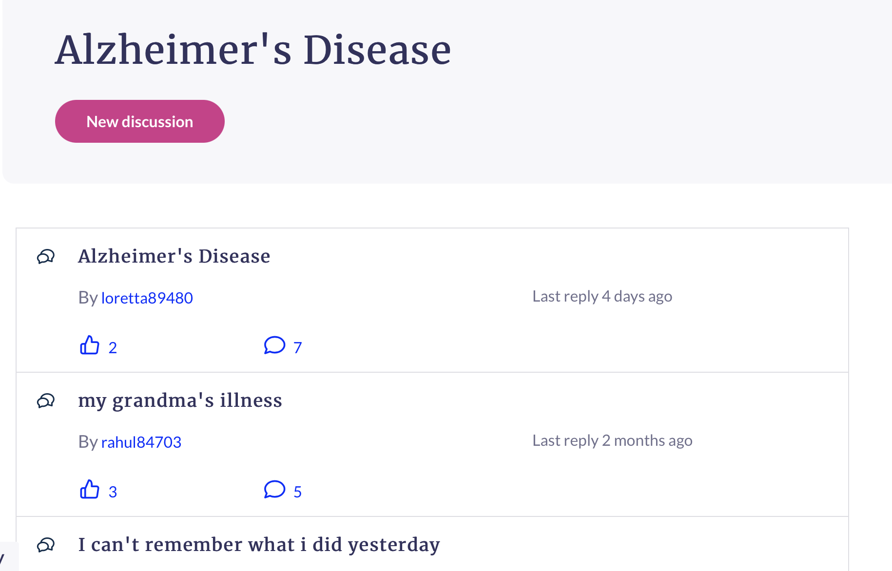
A LOOK INTO THE SCRAPED DISCUSSION FORUM
This project was based on a discussion forum about Alzheimer's Disease.
Every single word and design that you see on this webpage has a relative tag/element to it.

Slide 5
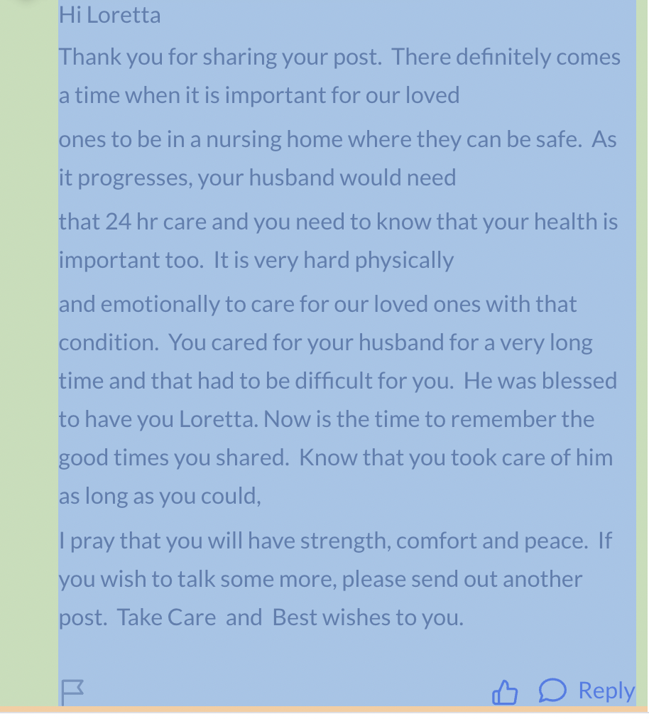
Respective tag and elements.

Slide 6
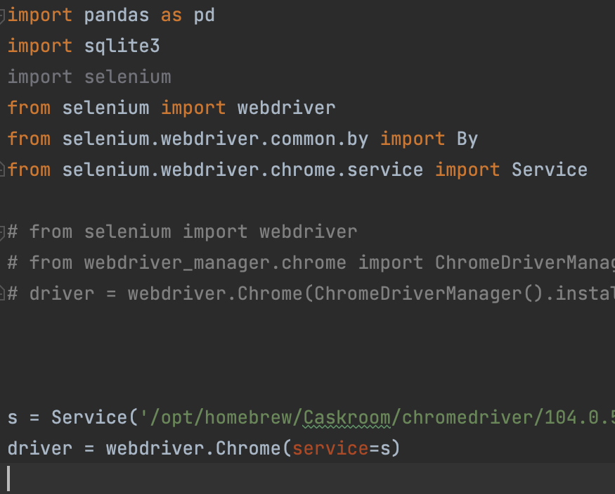
A look into the code
In the code, you want to import all libraries that are needed to process the information and the data needed from the website. Here we utilized sqlite3, panda as pd, and selenium.

Slide 7
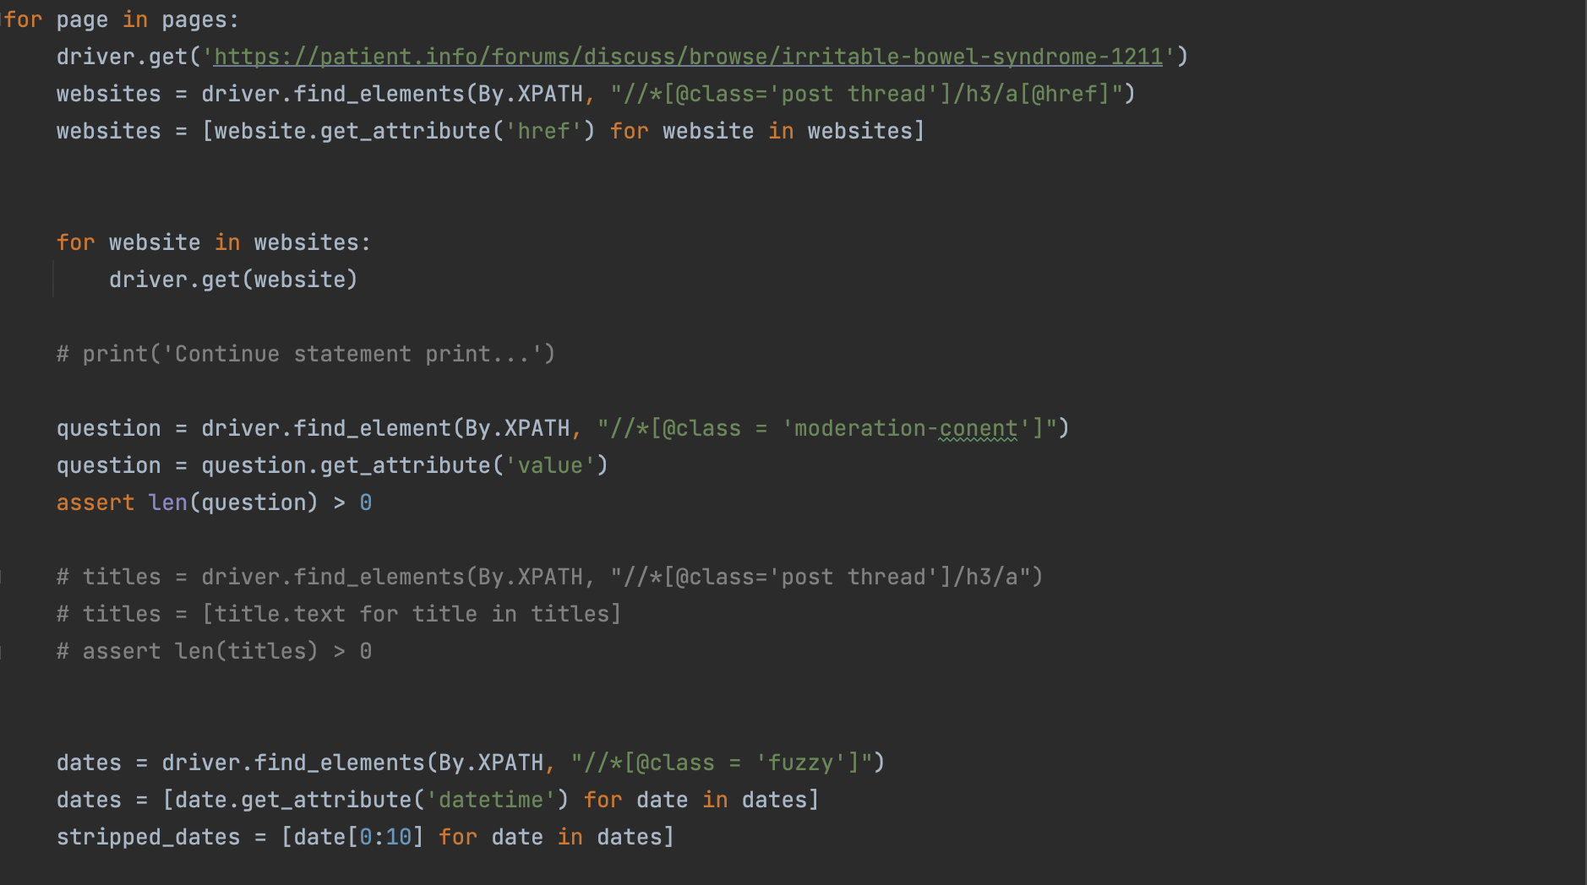
CONT’D. More details on website using ‘.get’ function.

Slide 8
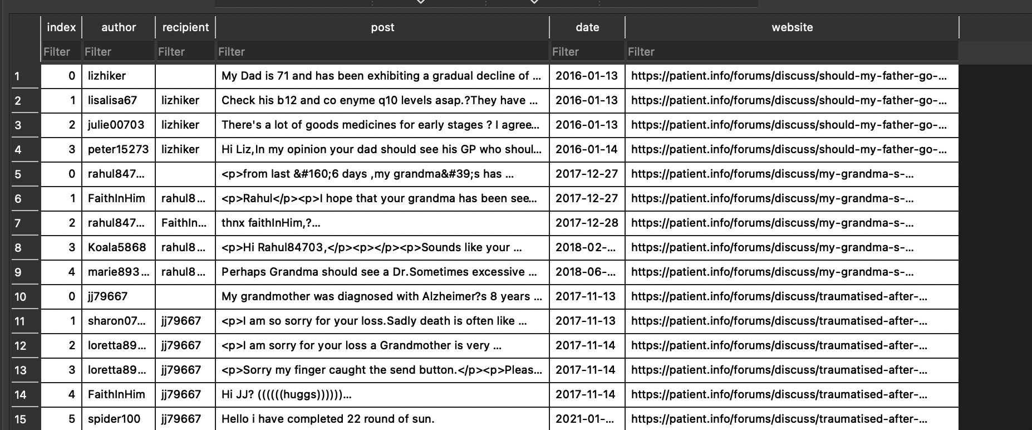
A look at the table after code WAS ran

Slide 9
Some findings and conclusion.
For analysis, it can be confirmed through analysis that not everyone gets a reply through a discussion.
To go into details of analysis, one can transfer the data from the SQL database into a CSV file which can be imported into another software called LIWC(Linguistic Inquiry Word Count).
The software runs a text analysis of each post and provides results such as word count or the ratio of words expressing positive emotions or relations to the future.

Slide 10
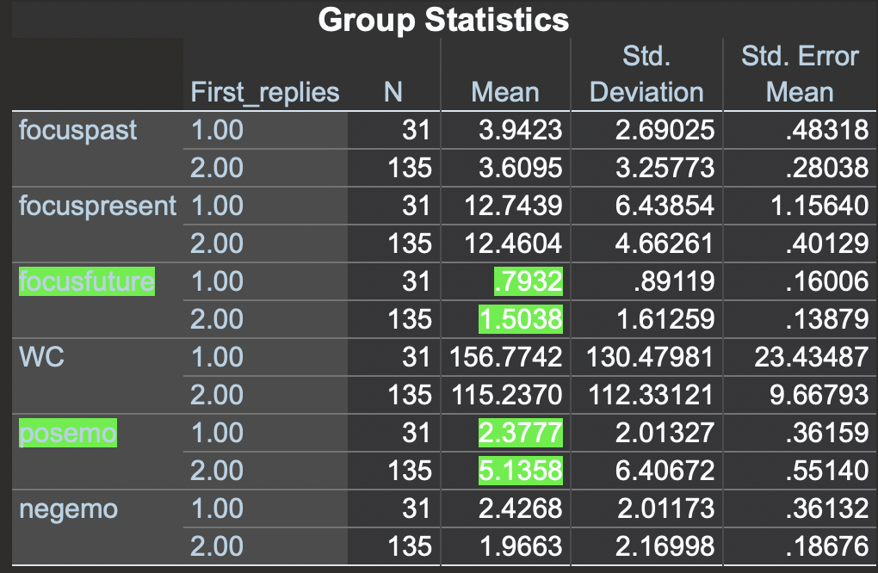
CONT’D
The graph on the left shows data for posts about alzheimers. Looking into the focus future category, it can be seen that the mean for person 2(replies) is twice more than person 1(the main post). The shows that replies shows significant focus of interest in the future.

Slide 11
CONT’D
The second parameter is the ‘posemo’ which stands for positive emotions. It can also be seen that the replies are about twice more than the main posts which shows that people that post a question about a concern usually focus on negative things with negative emotions.

Slide 12
This diagram on the right shows a negative relation between words per sentence and positive emotions. The longer the words in a sentence, the lower the percentage of positive emotions presented in the post.

Slide 13
TEXT-ANALYSIS AS A POWERFUL TOOL
This can be used in research to find out more on trends of the emotions that people go through when making certain posts.
In conclusion, replies to these kind of posts always focus on positive emotions compared to the main posts.
The replies focus more on the future, and maybe that from these results we learn that replies to original posts are an important source of consolation and encouragement for the original poster.

